Slide 1



Optimal Binary Switch Codes with Small Query Size
Zhiying Wang, Han Mao Kiah, Yuval Cassuto
Presenter: Junming Ke
junming.ke@ut.ee
Notes:
The paper is entitled with Optimal Binary Switch Codes with Small Query Size, and let me first introduce the authors briefly, Zhiying Wang, she is an assistant professor at the University of California, Irvine now, this work has been done during she was doing Post Doc at Standford University, Han Mao Kiah, an assistant professor from Nanyang Technological University, and Yuval Cassuto, the associate professor from Israel institute of technology.
and here is my email address, you can contact me if you have any questions after this class.

Slide 2
1 Background
2 Constructions
CONTENTS
3 Proofs
Notes:
This presentation will proceeds as background, Constructions, and the proofs of the important lemmas, and theorems.

Slide 3
1
Background

Slide 4

Background
A
B
Input data
Output data
A, B
A, B
Data center
Notes:
Ok, First of all, consider there are two servers in the data center, the data center wishes to store the input data A and B,
The naïve approach is to store each data in each server, when one of the data A or B is being requested, the corresponding server can respond with its stored data. In our real applications, we wish that the output data here is A and B with probability 50 percent, respectively.

Slide 5
Background
A
Input data
A, B
Data center
Output data
Use A twice
A, A
Notes:
However, the shortcoming of the above approach is, the output data can sometimes always are from server A, and server can’t support the request more than once due to the limit of the performance, here we can consider the consequence of multi-request is denial of service attack, that is, the attacker used to request from the server for multi times and the server doesn’t have the resources to respond to other requests.
Think about another case, if the server A is broken, the data A can’t be restored forever, which is unacceptable in real applications.

Slide 6
Background
A
B
A+B
Input data
Output data
A, B
{A}, {B, A+B}
Data center
=A, A
Notes:
Now, we consider a novel approach, we put two data sets into three servers, and we use plus to demonstrate the XOR calculations for binary data. In this case, the data center can respond with request A in two different ways, one if from server A directly, we will call this as singletons. Another method is respond with the data from other two servers, B and A plus B, so the client can do the XOR calculation for A and A plus B to get A. As illustrated here.

Slide 7
Background
A
B
A+B
Input data
Output data
A, B
{A}, {B, A+B}
Data center
A: | 10
B: | 01
A+B: | 11
Notes:
Here is an example, when A is equals to 10, B is 01, and A plus B is 11, so we can respond A with one zero, or we respond with 01 and 11, so that 10 can be obtained from 01 plus 11. OK, any questions so far.

Slide 8
Background
Problem:
Constructing switch codes solving arbitrary requests and having max query size 2.
Data center
Notes:
Ok, there are actually multiple constructions in Data center, that is, when comes into data, how to construct the stored data in data server, like we illustrated, there are A, B data, we construct A, B, and A+B, and store these data in the data server, here is the problem, which is exactly this paper going to answer. How to Construct switch codes solving arbitrary requests and having max query size 2.

Slide 9
2
Constructions

Slide 10
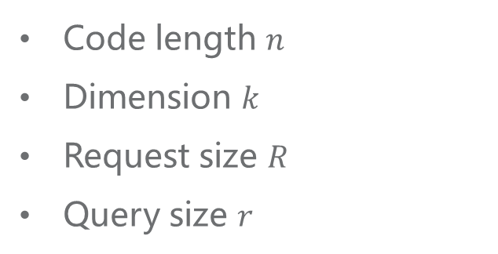

Definition
$(n, k, R)$switch codes
Code length $n$
Dimension $k$
Request size $R$
Query size $r$
Notes:
Ok, first definition is related to the Constructing switch codes, we call that (𝑛, 𝑘, 𝑅) switch codes if the code length is n, dimension is k, such that for every request size R, there is a solution such that the sets of codeword symbols for recovering the requested symbols are disjoint. Besides, the maximum number of codeword symbols used to recover an information symbol, is denoted by query size, r.

Slide 11
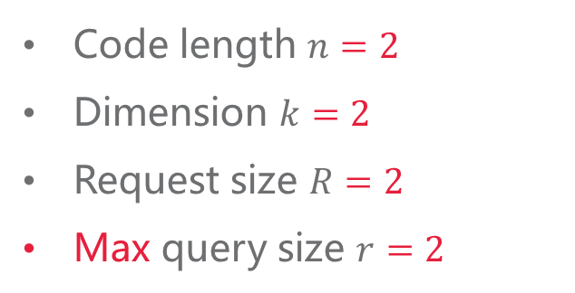
Definition
$(n, k, R)$switch codes
Code length $n=2$
Dimension $k=2$
Request size $R=2$
Max query size $r=2$
Code length $n$
Dimension $k$
Request size $R$
Query size $r$
A, B
A: | 10
B: | 01
A+B: | 11
Notes:
We treat the previous example as the switch codes, here code length and dimension is 2, and request size is equals to code length 2, for each request, for instance, A, we can respond with no much that 2 data to restore it, that is, we respond with A or B and A plus B, so the Max query size is 2.

Slide 12



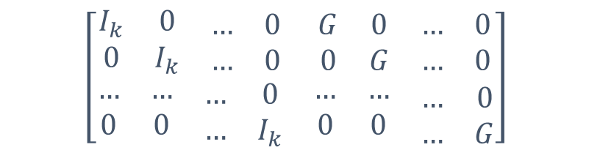
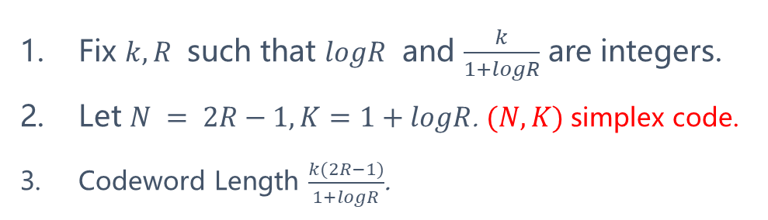

Construction
Fix $k, R$ such that $logR$ and $\frac{k}{1+logR}$ are integers.
Let $N = 2R−1, K=1+logR$. $(N,K)$simplex code.
Codeword Length $\frac{k(2R−1)}{1+logR}$.
$$K$$
$$N−K$$
$$\left[\begin{matrix}\begin{matrix}\begin{matrix}I_{k} & 0 \\ 0 & I_{k}\end{matrix} & \begin{matrix}… & 0 \\ … & 0\end{matrix}\end{matrix} & \begin{matrix}\begin{matrix}G & 0 \\ 0 & G\end{matrix} & \begin{matrix}… & 0 \\ … & 0\end{matrix}\end{matrix} \\ \begin{matrix}\begin{matrix}… & … \\ 0 & 0\end{matrix} & \begin{matrix}… & 0 \\ … & I_{k}\end{matrix}\end{matrix} & \begin{matrix}\begin{matrix}… & … \\ 0 & 0\end{matrix} & \begin{matrix}… & 0 \\ … & G\end{matrix}\end{matrix}\end{matrix}\right]$$
$$K$$
$\frac{k}{1+logR}$ groups, each group size $1+logR$
The above construction solves arbitrary requests and has query size 2.
Notes:
Ok, the construction is going to like this, we first fix k and r to make log R and k of 1 plus logR are integers, for example, we first fix R equals to 2 or 4, then logR is 1 or 2, and we wish K divided by 1 plus logR equals to an integer, 1 plus logR is 2 or 3, we can choose k as 4 or 6 so that this is 2.
We partite k information into $\frac{k}{1+logR}$ groups, each group contains size $1+logR$.
Next, we choose Capital N and K to generate $(N,K)$simplex code, We will instantiate (𝑁,𝐾) simplex code later.
we have R here, so N and K is determined.
Finally we have codeword length is this. Namely, is small n.
Ok, we will prove that The above construction solves arbitrary requests and has query size 2 in the proofs section.

Slide 13

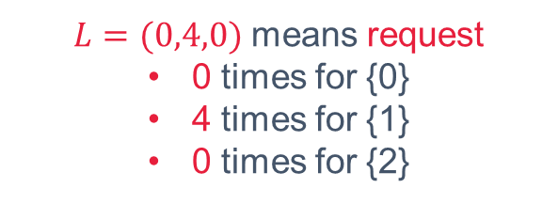


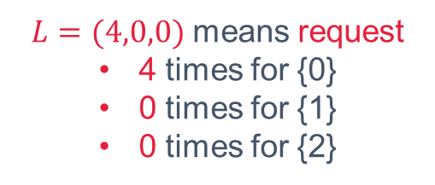
Construction example
$K=3$
$L=(4,0,0)$ means request
4 times for {0}
0 times for {1}
0 times for {2}
{0}
{1}
{2}
{0,1,2}
{0}
{1}
{2}
{0,1}
{0,2}
{1,2}
{0,1,2}
{$∅$}
{0,1}
{0,2}
{1,2}
$L=(0,4,0)$ means request
0 times for {0}
4 times for {1}
0 times for {2}
{0}
{1}
{2}
{0,1,2}
{$∅$}
{0,1}
{0,2}
{1,2}
Notes:
Here is an example of (𝑁,𝐾) simplex code where K = 3, we construct the code as 7 subsets, {0}, {1}, {2}, {0,1}, {0,2}, {1,2} and {0,1,2}, if we wish to recover a request 𝐿 equals to (4,0,0), this means 4 times for {0}, 0 times for {1}, and 0 times for {2}, we can easily construct the bipartite graph like this, put the odd partition on the below and the even partition on the bottom. We can reconstruct {0} by connect {0} and none subset, this means we only request from the single server, and other connection like illustrated, notice that all of the single bit can be reconstructed by connection from the odd partition to even partition.
Here is another example of the request 𝐿 equals to (0,4,0).

Slide 14
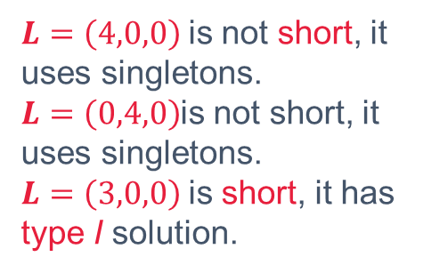
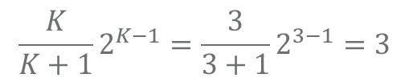

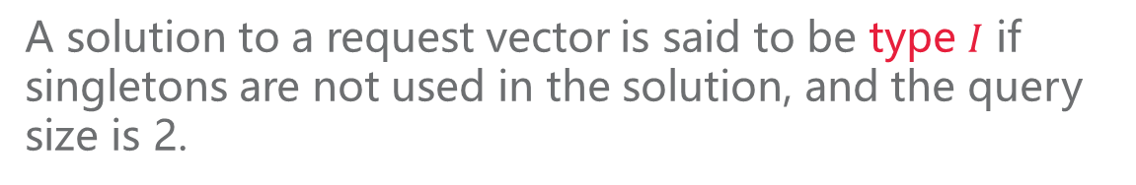
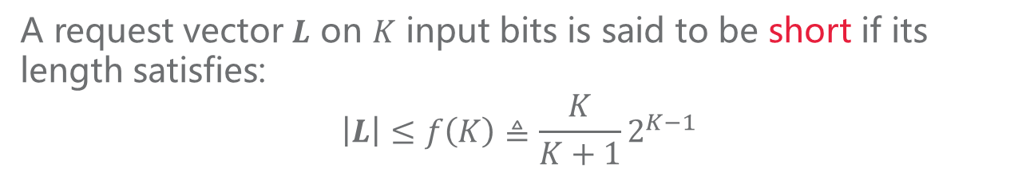
Definition
A request vector $L$ on $K$ input bits is said to be short if its length satisfies:
$$\left|L\right|≤f\left(K\right)≜\frac{K}{K+1}2^{K−1}$$
$K=3$
$$\frac{K}{K+1}2^{K−1}=\frac{3}{3+1}2^{3−1}=3$$
$L=\left(4,0,0\right)$is not short, it uses singletons.
$L=\left(0,4,0\right)$is not short, it uses singletons.
$L=\left(3,0,0\right)$is short, it has type I solution.
A solution to a request vector is said to be type $I$ if singletons are not used in the solution, and the query size is 2.
Notes:
Now we definite a A request vector 𝑳 on 𝐾 input bits is said to be short if its length satisfies:
|𝑳|≤𝑓(𝐾)≜𝐾/(𝐾+1) 2^(𝐾−1)
We also call A solution to a request vector is said to be type 𝐼 if singletons are not used in the solution, and the query size is 2.
In our example illustrated in the previous slide, namely, k is equals to three. We calculate f k here is three, and we notice that 𝑳=(4,0,0) and 𝑳=(0,4,0)is not short, it uses singletons.
However, 𝑳=(3,0,0) is short, it has type I solution. We can easily reconstruct {0} without singletons as illustrated, and also so does (0,3,0).
Ok, any problems so far, we are going to proofs.

Slide 15
3
Proofs

Slide 16
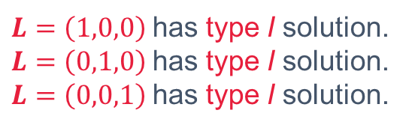




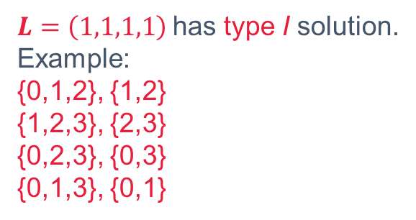
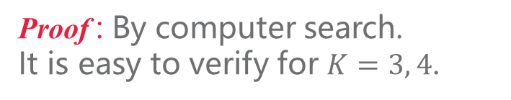



Lemma 6
$K=3$
There is a type $I$ solution to any request of length $2^{K−1}−K$, for $K≤8$.
$$2^{K−1}−K=1$$
$L=\left(1,0,0\right)$has type I solution.
$L=\left(0,1,0\right)$has type I solution.
$L=\left(0,0,1\right)$has type I solution.
Proof : By computer search.
It is easy to verify for $K=3, 4$.
$K=4$
There is a type $I$ solution to any short request for $K=8$.
$$2^{K−1}−K=4$$
$L=\left(1,1,1,1\right)$has type I solution.
Example:
{0,1,2}, {1,2}
{1,2,3}, {2,3}
{0,2,3}, {0,3}
{0,1,3}, {0,1}
Proof : $2^{K−1}−K≥\frac{K}{K+1}2^{K−1}$
Notes:
Firstly, we claim that There is a type 𝐼 solution to any request of length 2^(𝐾−1)−𝐾, for 𝐾≤8. The prove can be done by computer search, namely, brute force to list the possible cases for 𝐾≤8, we can easily to verify that it holds for 𝐾=3, 4.
Due to 2^(𝐾−1)−𝐾≥𝐾/(𝐾+1) 2^(𝐾−1), we can obtain that There is a type 𝐼 solution to any short request for 𝐾=8.

Slide 17
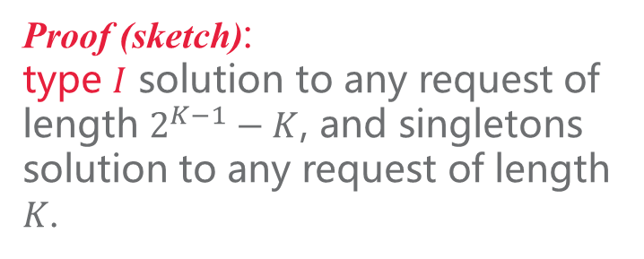
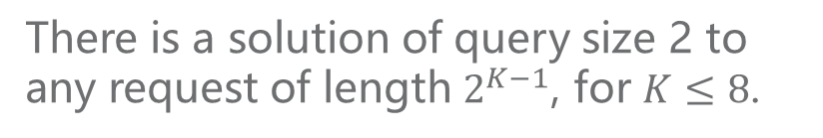
Lemma 6
There is a solution of query size 2 to any request of length $2^{K−1}$, for $K≤8$.
Proof (sketch):
type $I$ solution to any request of length $2^{K−1}−K$, and singletons solution to any request of length $K$.
Notes:
There is a type $I$ solution to any request of length $2^{K−1}−K$, for $K≤8$.
So we have There is a solution of query size 2 to any request of length 2^(𝐾−1), because we use the singletons to reconstruct the single bit for the K requests.

Slide 18
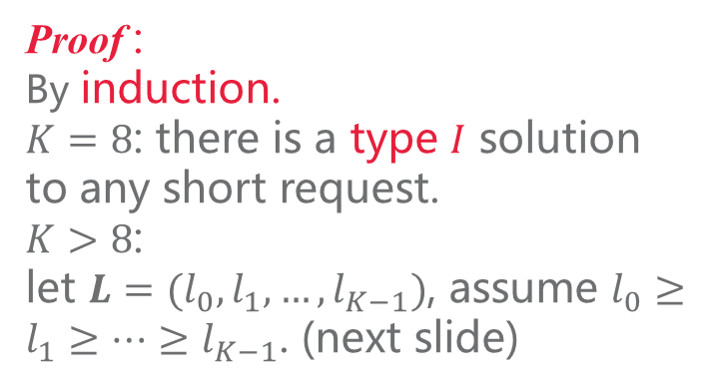

Lemma 6
There is a solution of query size 2 to any request of length $2^{K−1}$, for $K≤8$.
There is a type $I$ solution to any short request for $K≥8$.
Proof (sketch):
type $I$ solution to any request of length $2^{K−1}−K$, and singletons solution to any request of length $K$.
Proof :
By induction.
$K=8$: there is a type $I$ solution to any short request.
$K>8$:
let $L=(l_{0},l_{1},…,l_{K−1})$, assume $l_{0}≥l_{1}≥…≥l_{K−1}$. (next slide)
Notes:
Now we prove that There is a type 𝐼 solution to any short request for 𝐾≥8.
The method we adopted is induction, we have proved that 𝐾=8: there is a type 𝐼 solution to any short request.
Next we show that it is also satisfied for k > 8, first we definite the request as 𝑳=(𝑙_0,𝑙_1,…,𝑙_(𝐾−1)), without loss of general, we assume 𝑙_0≥𝑙_1≥…≥𝑙_(𝐾−1), if it is not, we can easily adjust the order of the request.

Slide 19
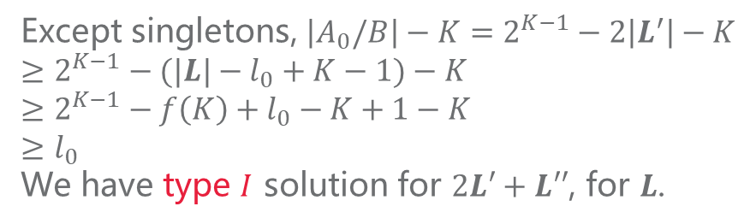

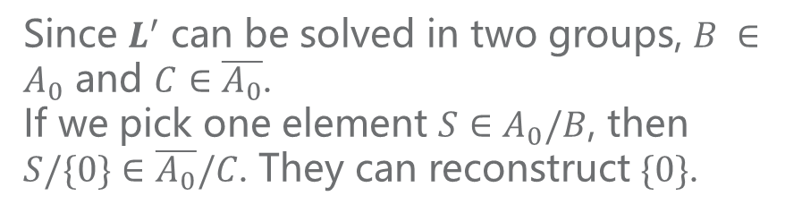

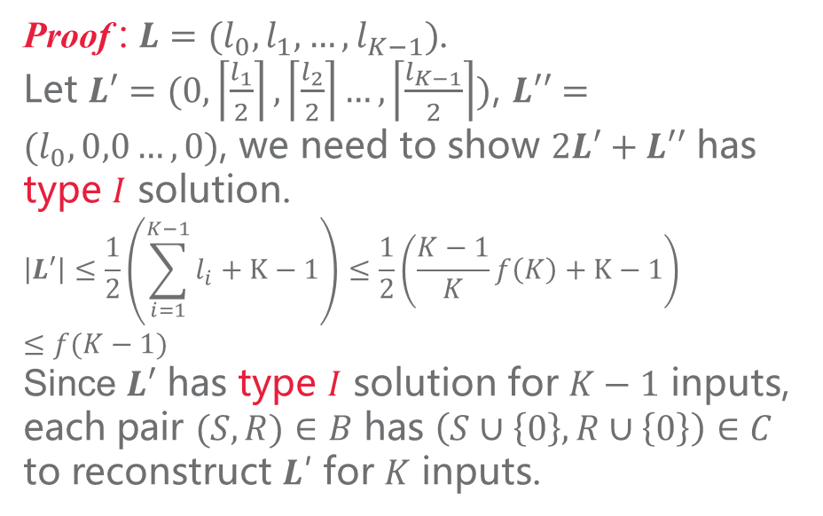
Lemma 7
Since $L^{′}$ can be solved in two groups, $B ∈A_{0}$ and $C∈\overline{A_{0}}$.
If we pick one element $S∈A_{0}/B$, then $S/\{0\}∈\overline{A_{0}}/C$. They can reconstruct $\{0\}$.
There is a type $I$ solution to any short request for $K≥8$.
Proof : $L=(l_{0},l_{1},…,l_{K−1})$.
Let $L′=(0,\left\lceil \frac{l_{1}}{2}\right\rceil ,\left\lceil \frac{l_{2}}{2}\right\rceil …,\left\lceil \frac{l_{K−1}}{2}\right\rceil )$, $L′′=(l_{0},0,0…,0)$, we need to show $2L′+L′′$ has type $I$ solution.
$$\left|L′\right|≤\frac{1}{2}\left(\sum_{i=1}^{K−1}{l_{i}}+K−1\right)≤\frac{1}{2}\left(\frac{K−1}{K}f\left(K\right)+K−1\right)≤f(K−1)$$
Since $L′$ has type $I$ solution for $K−1$ inputs, each pair $(S, R)∈B$ has $\left(S∪\left\{0\right\}, R∪\left\{0\right\}\right)∈C$ to reconstruct 𝑳′ for $K$ inputs.
Example:
{1,2}
{0,1,2}
{1}
{0,1}
{2}
{0,2}
{$∅$}
{0}
Except singletons, $\left|A_{0}/B\right|−K=2^{K−1}−2\left|L^{′}\right|−K$
$$≥2^{K−1}−(|L|−l_{0}+K−1)−K$$
$$≥2^{K−1}−f\left(K\right)+l_{0}−K+1−K$$
$$≥l_{0}$$
We have type $I$ solution for $2L′+L′′$, for $L$.
Notes:
We let 𝑳′=(0,⌈𝑙_1/2⌉,⌈𝑙_2/2⌉…,⌈𝑙_(𝐾−1)/2⌉) and 𝑳′′=(𝑙_0,0,0…,0) so if 2𝑳′+𝑳′′ has type 𝐼 solution. Then so does L.
Firstly, we could calculate the sum of L prime, because the upper bound of l1 is less than l1 plus 1, so the sum of upper bound of K minus 1, is the sum of K minus 1 plus K minus 1.
Because it is short request and the largest l is L0, so it is less that K minus 1 of K times f(K), and this is less than f(K-1), we can verify it by the definition of the function F k.
So that $L′$ has type $I$ solution for $K−1$ inputs, and for K inputs, we could assume that the new input as {0}, so that we have another pair (𝑆∪{0}, 𝑅∪{0}) to reconstruct L prime.
Since 𝑳^′ can be solved in two groups, 𝐵 ∈𝐴_0 and 𝐶∈(𝐴_0 ) ̅.
If we pick one element 𝑆∈𝐴_0/𝐵, then 𝑆/{0}∈(𝐴_0 ) ̅/𝐶. They can reconstruct {0}.
This is the illustration of the idea, we split the code into two groups, we can construct the L prime by the left without 0 and also by the right with 0, so that we can easily construct the code from left to right to reconstruct 0, it is the L double prime.
Ok, how many zero can we obtained without singletons? All of the pair without the reconstruction of two times L prime and without singletons, two times the length of L prime is less than the length of L plus K minus 1, due to the upper bound, of course, minus l zero. And it is fk, we can use the function of fk and get this is larger than l zero, means it can solve L double prime.

Slide 20
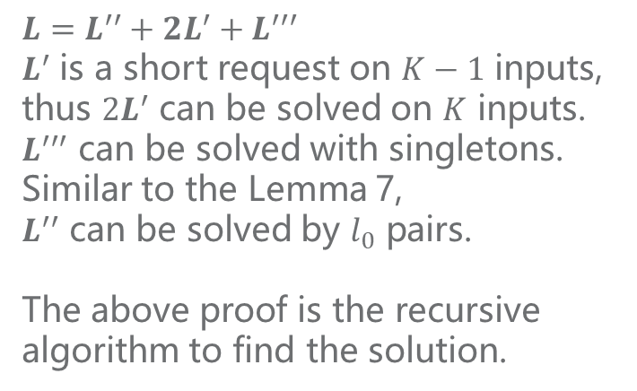
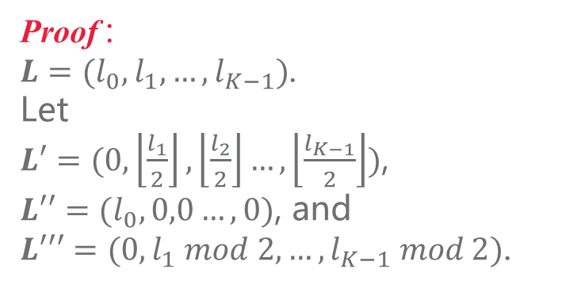
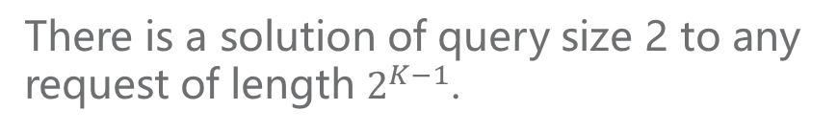
Theorem 8
There is a solution of query size 2 to any request of length $2^{K−1}$.
$$L=L^{′′}+2L^{′}+L^{′′′}$$
$L^{′}$ is a short request on $K−1$ inputs, thus $2L^{′}$ can be solved on $K$ inputs.
$L^{′′′}$ can be solved with singletons.
Similar to the Lemma 7,
$L^{′′}$ can be solved by $l_{0}$ pairs.
The above proof is the recursive algorithm to find the solution.
Proof :
$L=(l_{0},l_{1},…,l_{K−1})$.
Let
$L′=(0,\left\lfloor \frac{l_{1}}{2}\right\rfloor ,\left\lfloor \frac{l_{2}}{2}\right\rfloor …,\left\lfloor \frac{l_{K−1}}{2}\right\rfloor )$,
$L′′=(l_{0},0,0…,0)$, and
$L′′′=(0,l_{1} mod 2,…,l_{K−1} mod 2)$.
Notes:
Ok we are going to prove There is a solution of query size 2 to any request of length 2^(𝐾−1).
So we advance it with short request to this request, it is easy to prove with the same technique adopted in the previous slide, we choose L1 as $L′=(0,\left\lfloor \frac{l_{1}}{2}\right\rfloor ,\left\lfloor \frac{l_{2}}{2}\right\rfloor …,\left\lfloor \frac{l_{K−1}}{2}\right\rfloor )$,
$L′′=(l_{0},0,0…,0)$, and additionally, we have
$L′′′=(0,l_{1} mod 2,…,l_{K−1} mod 2)$.
$L^{′}$ is a short request on $K−1$ inputs, thus $2L^{′}$ can be solved on $K$ inputs.
$L^{′′′}$ can be solved with singletons.
Similar to the Lemma 7,
$L^{′′}$ can be solved by $l_{0}$ pairs.
So The above proof is the recursive algorithm to find the solution.

Slide 21
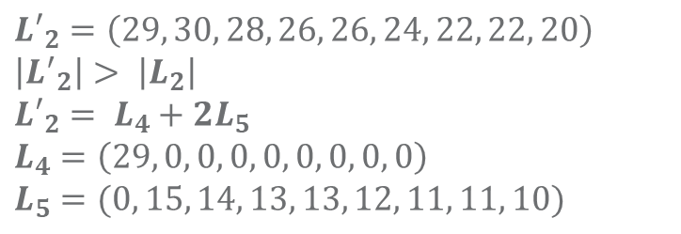
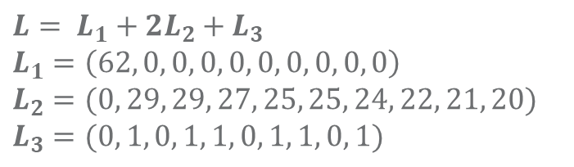
Example
$$L=\left(62, 59, 58, 55, 51, 50, 49, 45, 42, 41\right)$$
$${L′}_{2}=\left(29, 30, 28, 26, 26, 24, 22, 22, 20\right)$$
$$\left|{L^{′}}_{2}\right|> \left|L_{2}\right|$$
$${L′}_{2}= L_{4}+2L_{5}$$
$$L_{4}=\left(29, 0, 0, 0, 0, 0, 0, 0, 0\right)$$
$$L_{5}=(0, 15, 14, 13, 13, 12, 11, 11, 10)$$
$$L= L_{1}+2L_{2}+L_{3}$$
$$L_{1}=\left(62, 0, 0, 0, 0, 0, 0, 0, 0, 0\right)$$
$$L_{2}=(0, 29, 29, 27, 25, 25, 24, 22, 21, 20)$$
$$L_{3}=(0, 1, 0, 1, 1, 0, 1, 1, 0, 1)$$
Notes:
Here is an example of recursive algorithm, for a request $L=\left(62, 59, 58, 55, 51, 50, 49, 45, 42, 41\right)$, we first split is into L1, L2 and L3, L1 can be recovered from the connection of two group, L3 can be recovered from singletons, now we generate L2 prime is larger than L2, means that if we can solve L2 prime, and we can solve L2, we split L2 prime to L4 and L5, L4 can be recovered from the connections and L5 is in K less than 8 case, we can reconstruct it by computer search.

Slide 22
Thanks for your attention.
Notes:
Ok, that’s all my presentation, thanks for your attention.

